Slide 1
SWE 4701
Software Metrics and Process
Lec - 7

Slide 2
Measuring reliability & test metrics

Slide 3
WHAT IS RELIABILITY?
Software reliability is the probability that a software system will function without failure under a given environment and during a specified period of time.
We already know:
Faults are defects that are in a system.
Failures are faults that occur in operation.
Defect metrics measure faults.
Reliability metrics measure failures.
If the faulty code is never executed in operation, then the system never fails. The mean-time-between-failures (MTBF) will approach infinity. The software availability will be 100%.

Slide 4
Failure Intensity
Failure intensity is the number of failures per unit
Initially, we always measured it per unit of time, where time was clock time.
Examples:
  Failures per hour
  Failures per day
  Failures per minute
This method was simple but not always meaningful.
Problem with Clock Time Measurement
  Systems are not always actively used.
  Failures may appear lower simply because users are not interacting with the system.
  Therefore, reliability results may be misleading.

Slide 5
Failure Intensity
Improved Approach
  Failure intensity is measured using the natural usage unit of the system.
  The “unit” depends on how the system is used.
Examples
  ATM System: Failures per 1,000 transactions
  Web Server: Failures per 10,000 requests
  Online Banking: Failures per number of user operations
Measuring failures based on actual system usage provides a more accurate and meaningful reliability measure.

Slide 6
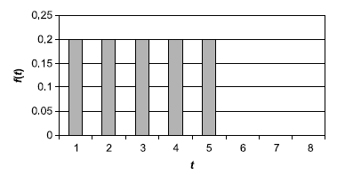
SW reliability engineering
The basic objective in reliability engineering is to predict when a system will fail.
Failure is probabilistic.
The probabilities vary over time, we can graph them and model them, and, for each model, there can be a probability distribution function (PDF).
Let us look at a simple software reliability model.
Suppose we have a software component that we know will fail sometime within 5 days, and it may fail any time up to that point with equal probability.
Then, where t is an integer, f (t) = 1/5 for t = 1 to 5, and f (t) = 0 for t > 5
In this case, f (t) has a uniform distribution; that is, the probability is the same (20%), that it will fail any day until day 6.

Slide 7


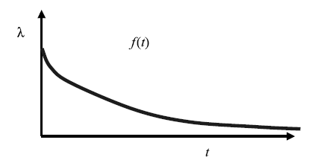
SW reliability engineering
The most common model uses a random distribution
Failures occur randomly over time
that is, they are independent of the past events. That is, the probability of failure is equivalent for each time period t, given that the system has not failed before time t.
This is also called an exponential distribution. The equation is
λ is also called the instantaneous failure rate, or hazard rate, and is the reciprocal of the mean-time-to-failure (MTTF). That is,
Note that f(t) never reaches 0.

Slide 8
Mean Time to Failure (MTTF)
Mean Time to Failure (MTTF) is the average time a software system operates before a failure occurs.
In software, a failure may include:
• Application crash
• System outage
• Service interruption
• Critical runtime error
Example
An online banking system runs continuously. Over a monitoring period, the system crashes several times.
Failure | Time between Failure
1 | 20 hours
2 | 35 hours
3 | 25 hours
4 | 40 hours
Total operating time = 20 + 35 + 25 + 40 = 120 hours
MTTF = 120 / 4
In reliability engineering, MTTF is also connected to failure rate.
If the failure rate is high, the MTTF becomes small, meaning the system fails quickly.
If the failure rate is low, the MTTF becomes larger, meaning the system lasts longer.

Slide 9



SW reliability Mode
MTTF is the mean time to failure. If you have failure data, with n different failure points of t1 through tn, then
But, If you have a probability distribution f (t), then MTTF = expected value of f (t), which is just
For the exponential distribution

Slide 10


Example
Here are three examples of calculating MTTF.
The system periodically fails. You track it for one month. It fails on days 2, 7, 8, 16, 22, and 31. To calculate the MTTF, you need to look at the intervals between failures. Assuming you started on day 1, the intervals are 1, 5, 1, 8, 6, and 9 days.
The system periodically fails. You track the length of time it takes to fail and find that f(1) =10%; f(2) = 15%; f(3) = 20%; f(4) = 25%; f(5) = 30%; all other f(x) = 0.
3. You have an exponential distribution. The MTTF is 2 days. Therefore, λ = 1/MTTF =1/2= 0.5.
Therefore
Continuing with the previous example, the probability of failure on the 10th day will be
But, exponential distributions have a memoryless property. That is, If the system has already survived 9 days, the probability of failure in the next day does not depend on those 9 days. So the probability of failure on day 10 given survival to day 9 is the same as the probability in the first day.

Slide 11



The Probability of Failure During a Time Interval
The probability of failure between any two points of time is the area under the curve of f(t), which is the integral of f(t): that is,
For our example of uniform distribution, the probability of failure between t1 and t2 is
For exponential distribution, the probability of failure between t1 and t2 is

Slide 12
Example
uniform distribution
The probability of failure between time 3 and time 4 for our uniform distribution will be :
0.2(4 - 3) = 0.2 or 20%
exponential distribution
2. The probability of failure between time 5 and time 6 for our exponential distribution will be :
The result is dependent on λ . For λ= 1, the probability of failure will be 0.004.
If the MTTF is 10 what will be the probability of failure??
λ = 1/10 = 0.1
So, the probability of failure between time 5 and 6 will be 5.7%

Slide 13

F(t ): The Probability of Failure by Time T
The probability of failure by time t is written F(t).
This is the failure function used in reliability.
it is equivalent to the probability of failure during the interval 0 to t.
F(t) is a cumulative distribution function (CDF), whereas f(t) is a probability distribution function (PDF).
For our uniform distribution, F(t) = 0.2t, where t is an integer ≤5, and it is 0 for t>5.
For our exponential distribution,
For our uniform distribution, the probability of failure through day 4 will be 0.2* 4 = 0.8 = 80%.
For our exponential distribution, assuming λ = 0.1, the probability of failure through day 7 would be:

Slide 14



R(t): The Reliability Function
The reliability function is the probability that the system has NOT failed by time t.
Therefore, it equals one minus the probability it HAS failed by time t.
For our uniform distribution,
For the exponential distribution

Slide 15



Exercise
If the MTTF is 10 days, what is the reliability function? What is the probability that it will not fail in the first five days?
$$λ=\frac{1}{MTTF}=\frac{1}{10}=0.1$$
$$R\left(t\right)=e^{−\text{λ}t}$$
$$R\left(t\right)=e^{−\text{0.1}t }$$
$R\left(5\right)=$ $e^{−\text{0.}5}=0.606=60\%$

Slide 16
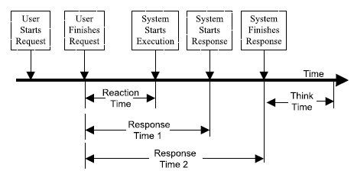

Response Time and Availability
Response Time: Response time is the interval between a user’s request and the system’s response.
Consider the following specifications for response time:
1. The response time must be ≤ 8 seconds.
2. The response time as measured from the user submit to the system starts response must be ≤ 8 seconds.
3. The response time as measured from the user submit to the system starts response must be:
(a) Maximum ≤ 30 seconds (b) Average ≤ 6 seconds
4. The response time as measured from the user submit to the system starts response must be:
(a) 95 percentile ≤ 8 seconds (b) 100 percentile ≤ 30 seconds
Which specification do you like the best, regardless of the actual numbers?
Response time is measured in elapsed time: you need to specify both a start and stop event.
It is frequently reported or specified with a minimum, maximum, and average or as a statistical distribution.
The best measure of a system’s response time during real operations is a “percentile” metric. The 95-percentile metric indicates that 95% of the transactions have a response time at or less than that number.

Slide 17
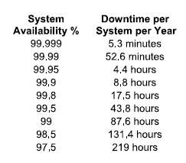
Response Time and Availability
Your boss, tells you that your new system should have “five nines” availability.
five nines means 99.999% availability.
Availability: The probability that a system is operational and accessible when required for use.
We define it as Availability = MTTF/(MTTR + MTTF).
This is just uptime/(uptime + downtime).
If a system goes down once a week for 5 hours, what is the availability?
Number of hours per week = 7 * 24 = 168
Availability = (168 - 5)/168 = 0.97 which is 97%

Slide 18
Response Time and Availability
Your boss, tells you that your new system should have “five nines” availability.
five nines means 99.999% availability.
Availability: The probability that a system is operational and accessible when required for use.
We define it as Availability = MTTF/(MTTR + MTTF).
This is just uptime/(uptime + downtime).
If the typical time between failures is 48 hours, and the typical time the system is down is 10 minutes, what is the availability?
Availability = MTBF/(MTBF + MTTR)
= 48/[48 + (10/60)]
= 0.996 which is 99.6%

Slide 19
Response Time and Availability
The two factors that impact availability are:
  Frequency of outages (MTTF) - how often the system goes down
  Duration of outage (MTTR) - how long it takes to bring it back up
Remember that if the MTTR approaches 0 in duration, the availability approaches 100% even if the MTTF is once per hour.
The length of the outage (MTTR) is impacted by several factors:
  System Complexity: Complicated systems take longer to start and restart, which makes the outages longer.
  Problem Severity: Usually, the more severe the problem, the more time it takes to fully resolve and restore the system.
  Support Personnel Availability: Time to contact staff + Time to access system + Time to fix.
  Other Miscellaneous Factors: There can be a variety of these, such as a third party supplier who can’t fix the part quickly enough, or potentially, you cannot take the system offline to fix your application because other applications are running on the server.

Slide 20
Response Time and Availability
A good system performance drops to average or poor performance if you cannot get support personnel instantaneously.
If the typical time between failures is 48 hours, and the typical time the system is down is 10 minutes, what is the availability if it takes 2 hours to get the right person to get the system back up?
Availability = MTBF/(MTBF + MTTR)
= 48/[48 + (2+ 10/60)]
= 0.957 which is 95.7%

Slide 21
Complexities in Measuring Availability
How would you measure availability for a banking system in which the server and networks are up 100%, except for scheduled maintenance, which is from 2 a.m. to 3 a.m. on Sunday mornings?
There are two different criteria for availability:
  Continuous availability(CA): For continuous availability, the system or application is to be available 7 X 24 with no outages
  High availability (HA) : the system or application is to be available during the committed hours of availability with no unplanned or unscheduled outages
consider if during a month, there were 9 hours of outage due to a hard disk crash and 15 hours due to preventive maintenance. Find CA and HA
Continuous Availability = (720 - 15 - 9)/720 = 96.7%
High Availability = (720 - 15 - 9)/(720 - 15) = 98:7%

